Slide 1













PACKSMART
PRESENTED BY NILKANTH PANARA(D22DCS169)
KRITA MARADIA(D22DCS170)
DARSHAN MANAVADARIYA(D22DCS172)

Slide 2
Table of
CONTENTS
01
Definition
02
Scope Of Project
03
Purpose
04
Diagrams
05
Technology
06
Screenshots

Slide 3







DEFINITION

Slide 4
I am developing an app called "PACKSMART" that will make it simple for users to pack for vacations without missing anything. It will be simple to use, allowing even the average individual to utilize it effectively. It will generate an essential list that applies to everyone and predicts that one may also add or delete items from the list in accordance with one's needs. Another option is to create a brand-new list of options. At the conclusion, it will show the entire marked list or list of items in one frame so that you can see if anything is still there or not. The families that are traveling with their infants will find this application to be quite helpful.

Slide 5
SCOPE OF PROJECT

Slide 6
Packing Checklist: The application provides a packing checklist that users can customize based on their specific trip requirements. The checklist may include categories like clothing, toiletries, electronics, travel documents, and miscellaneous items.
Item Suggestions: The application can provide suggestions and recommendations for essential items to pack based on the user's trip details.
Personalization: Users can create personalized list and save their preferences.

Slide 7
PURPOSE

Slide 8
The main purpose of this application is to help the travellers while packing for the trip without forgetting any small thing.
By this the travellers need not to worry about anything, they just need to checklist the items added in their bags.
This application will play an important role the the families travelling with their babies.

Slide 9
DIAGRAMS

Slide 10
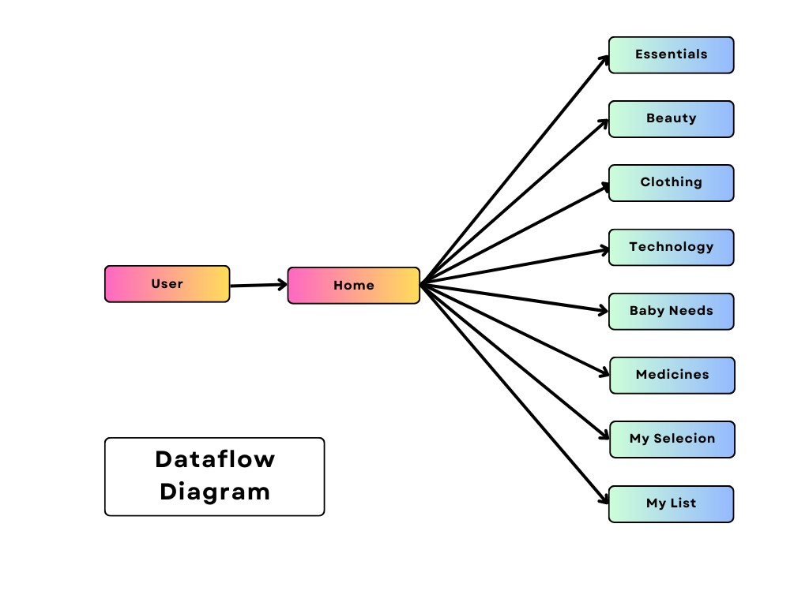
Dataflow Diagram

Slide 11
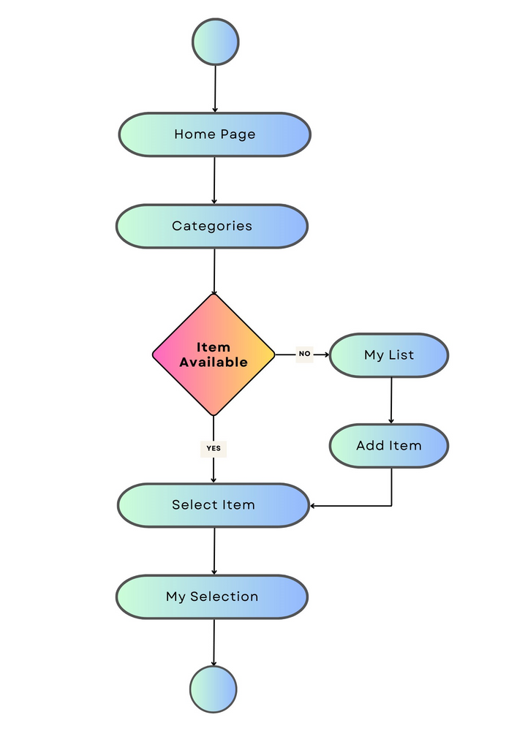
Activity Diagram

Slide 12
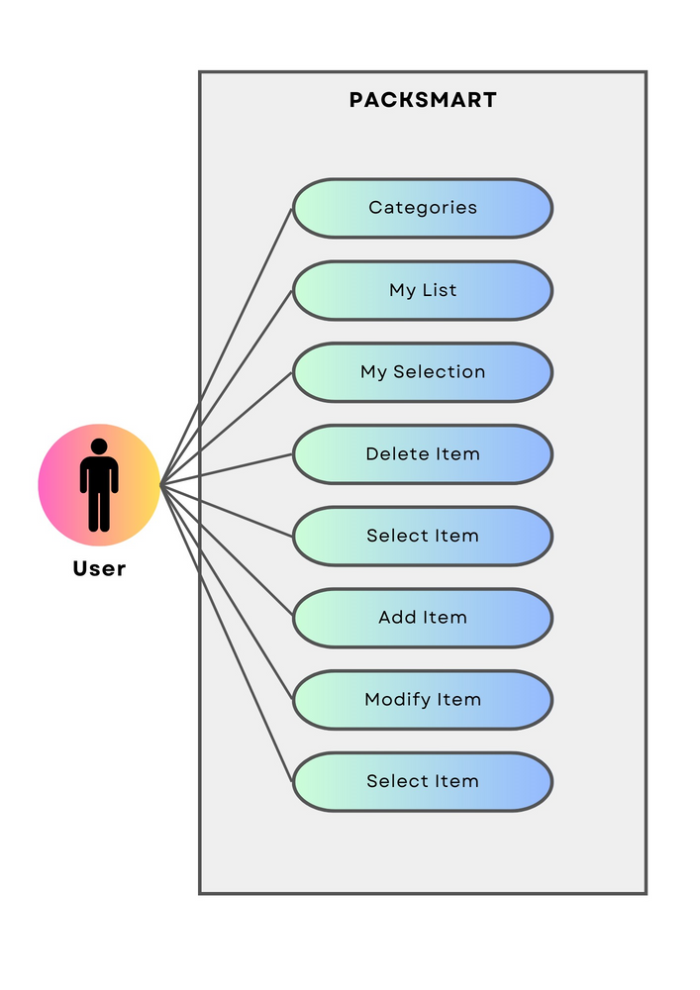
Use-Case Diagram

Slide 13
TECHONOLOGY

Slide 14




Java
Android
Firebase
BACKEND
FRONTEND
DATABASE

Slide 15
SCREENSHOTS

Slide 16
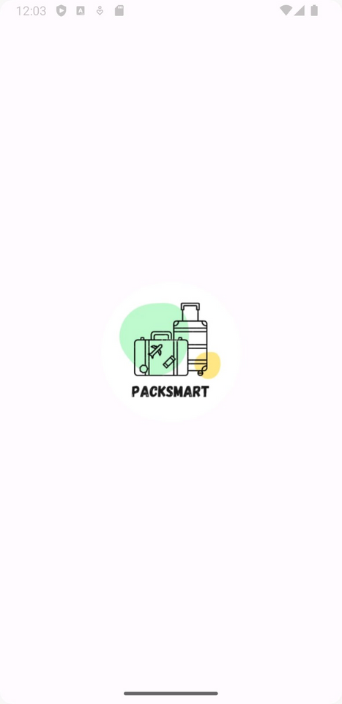
Splash Screen

Slide 17
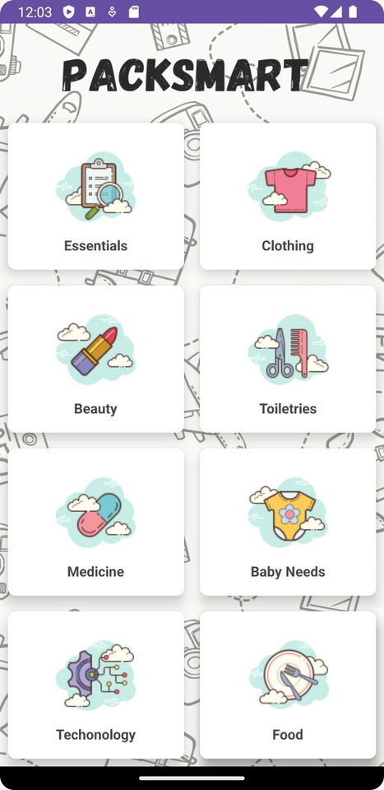
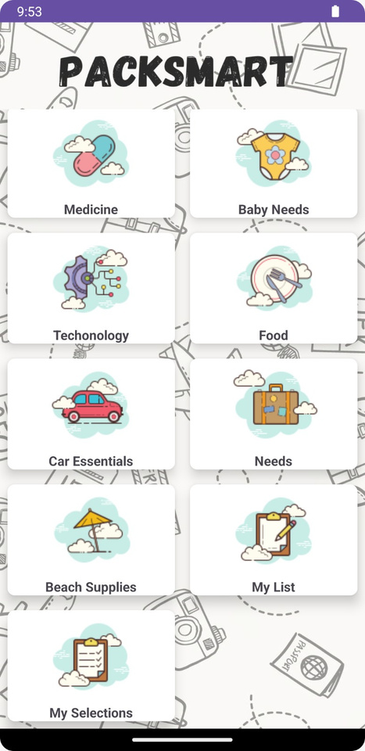
Home Screen

Slide 18
THANK YOU

